Slide 1
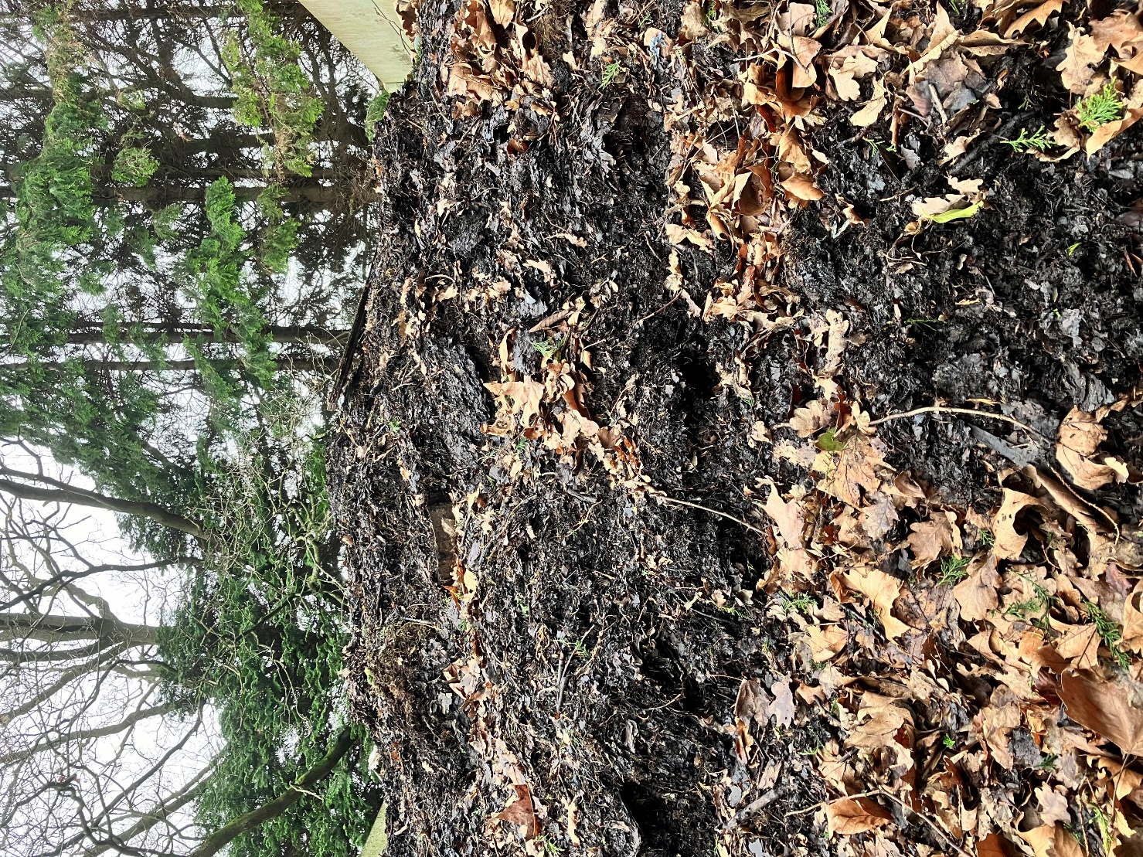
enacting hope in a ruined world
Revd Dr Al Barrett (and friends!)

Slide 2
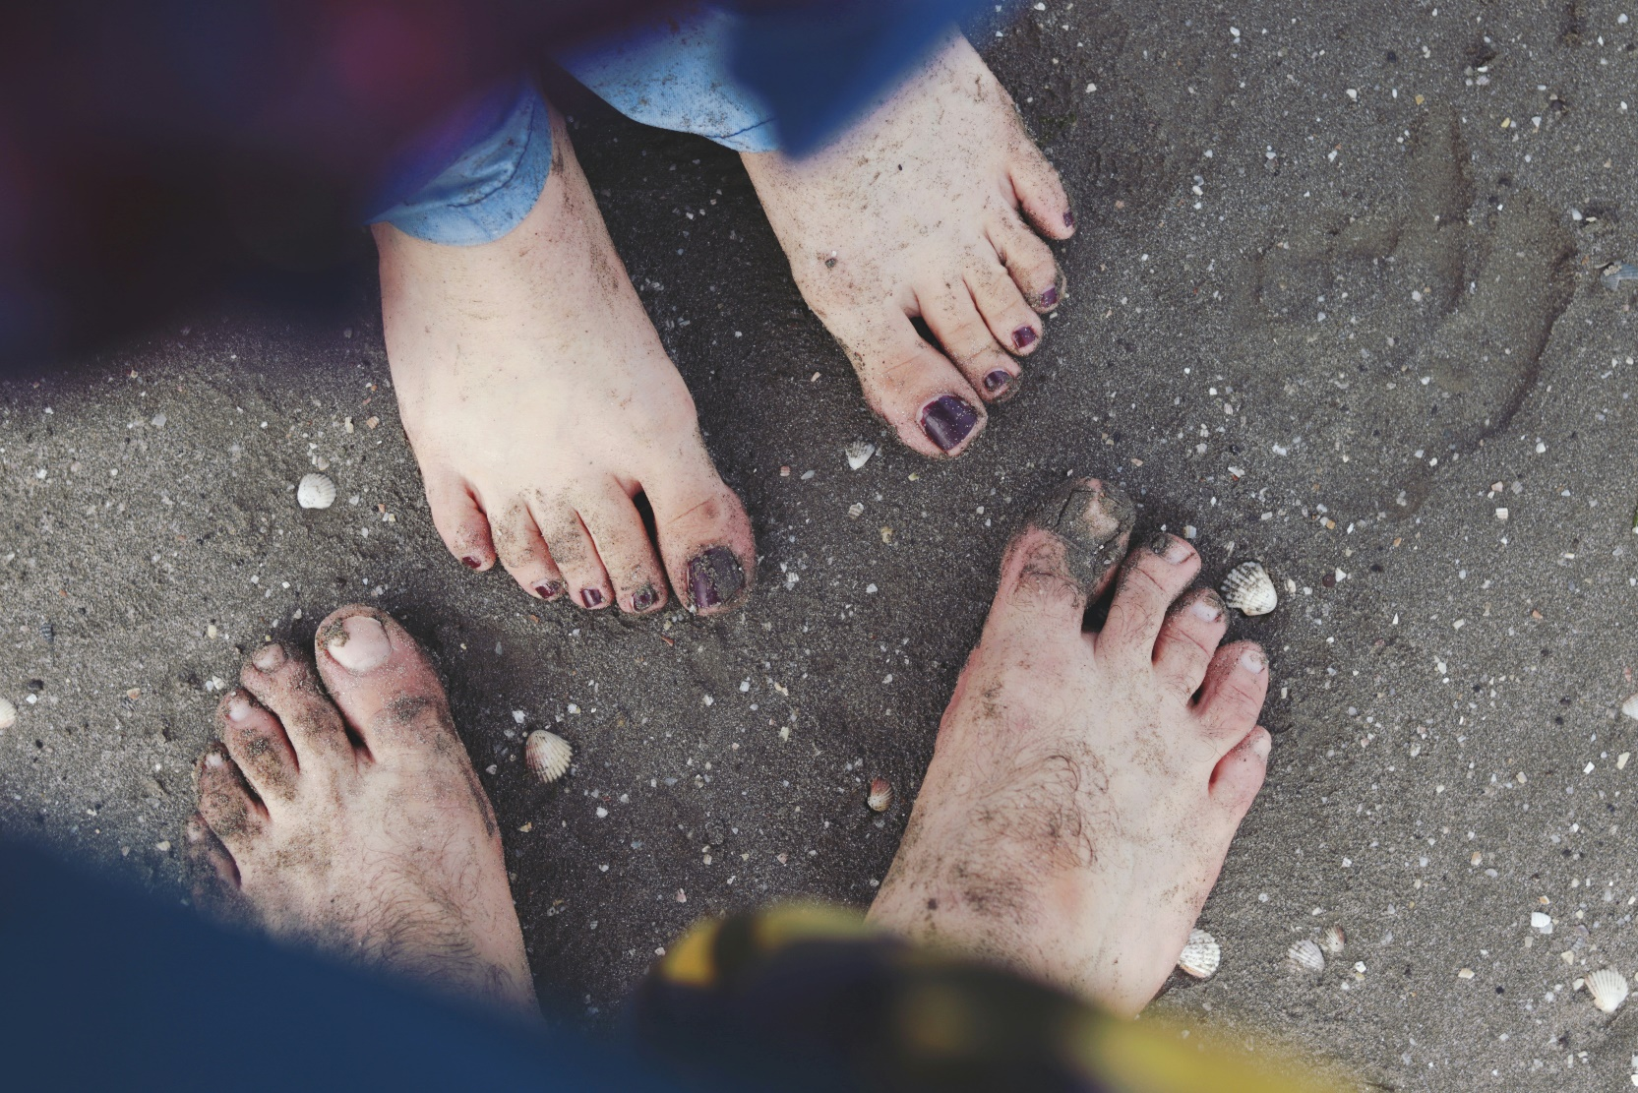

Slide 3

doing theology on the compost heap
What are you particularly aware of that is decomposing, falling apart, rotting, dying?
Personal
Local
Regional
Ecclesial
National
Global

Slide 4
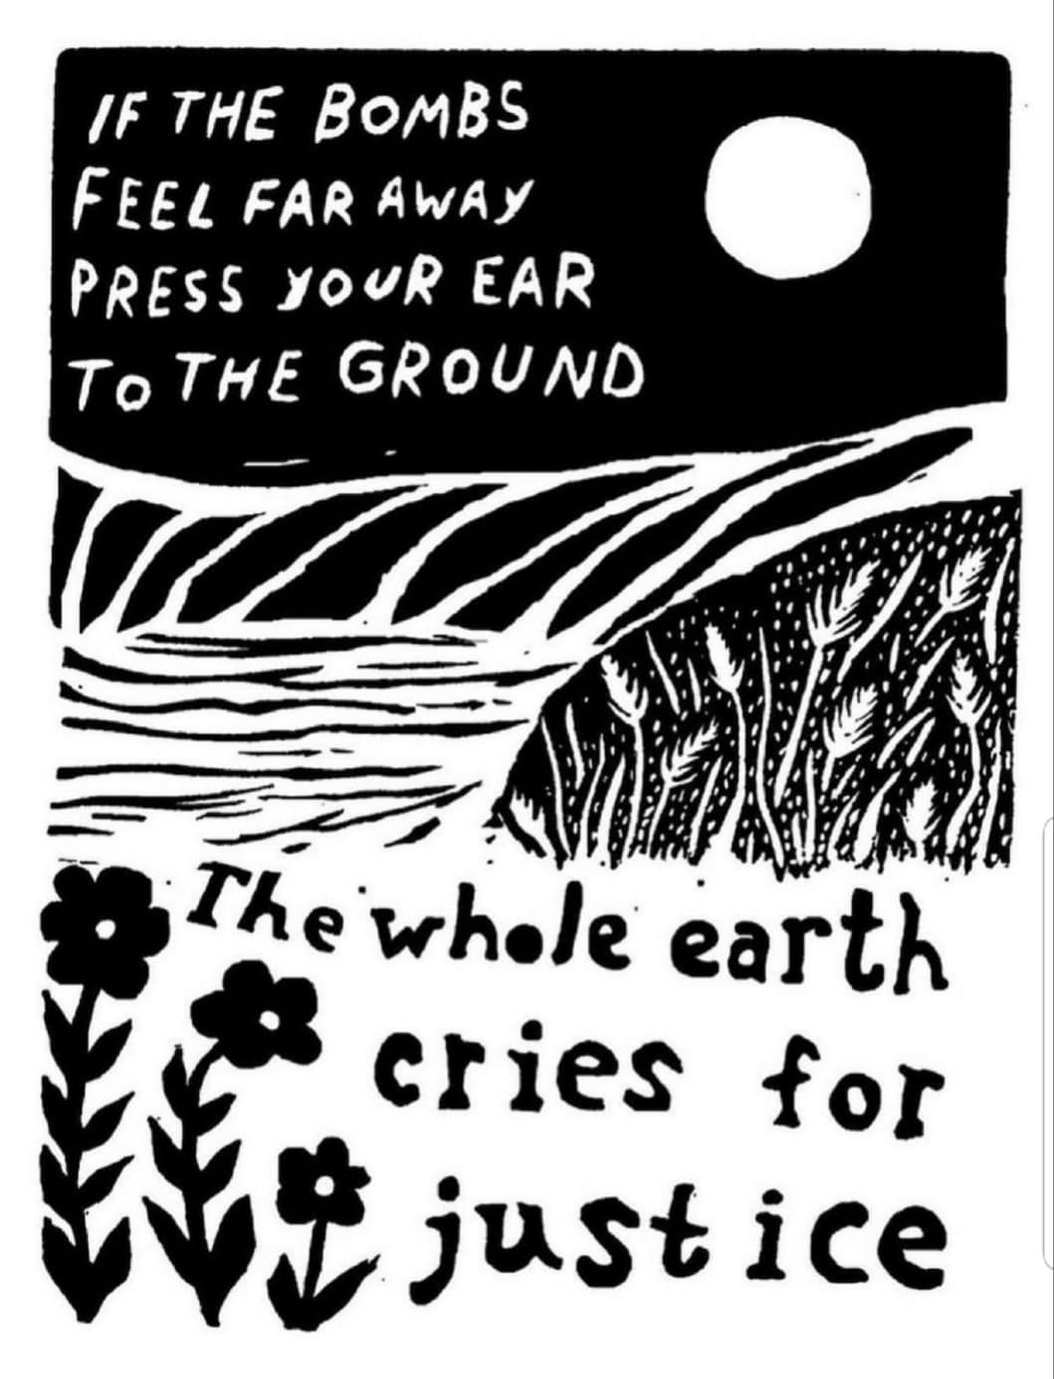
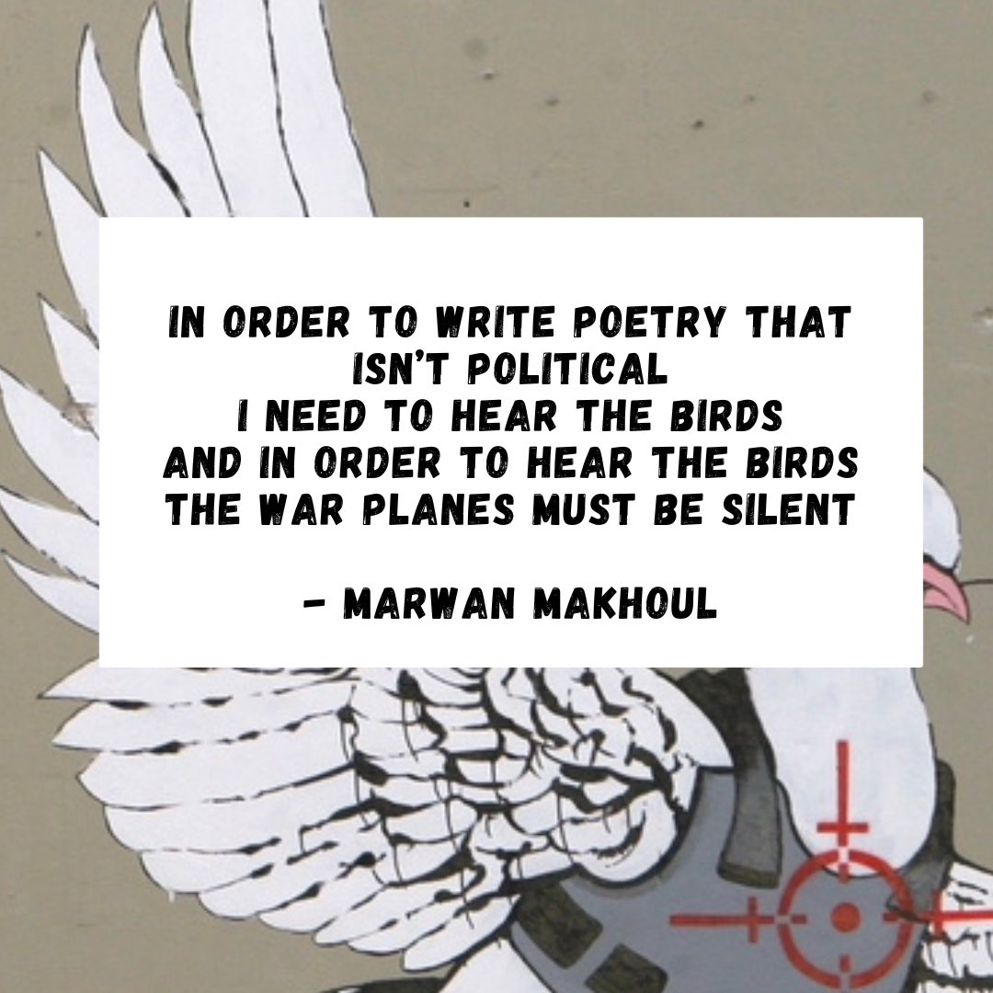
Marwan Makhoul, b.1979, Palestinian poet

Slide 5
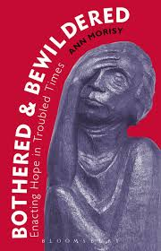
‘proclaimed hope’ or ‘enacted hope’?
‘The group develops a jargon unique to itself, often non-understandable to outsiders. This jargon consists of numerous words and phrases which the members understand (or think they understand), but which really acts to dull one’s ability to engage in critical thinking. It is actually made up of thought-terminating clichés. The most far-reaching and complex of human problems are compressed into brief, definitive-sounding phrases, easily memorized and easily expressed. Thought-provoking complexities are bypassed and ultimate truth is expressed in a single phrase or even a word.’
(Robert Jay Lifton, Thought Reform and the Psychology of Totalism, 1989)

Slide 6
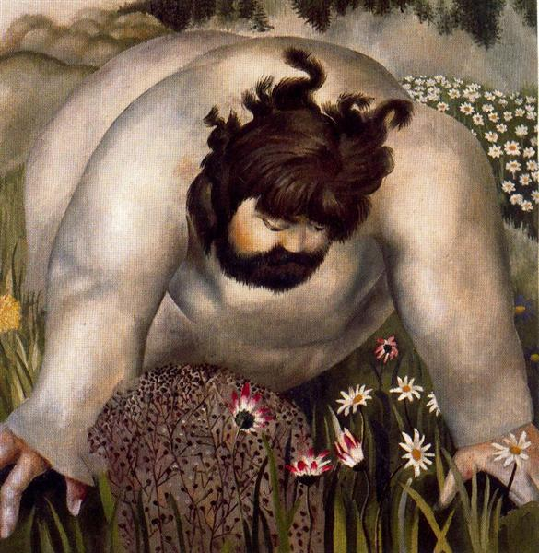
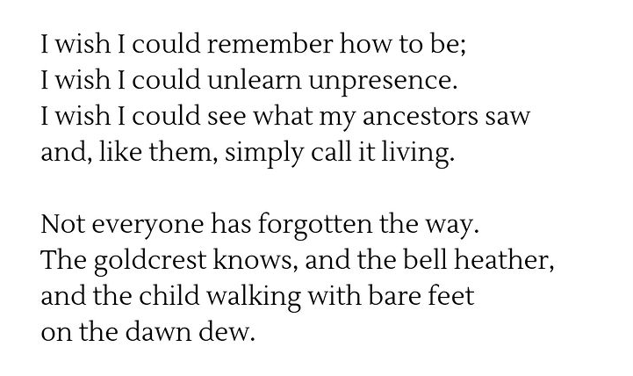
Gideon Heugh

Slide 7
enacting hope in a ruined world
Revd Dr Al Barrett (and friends!)

Slide 8
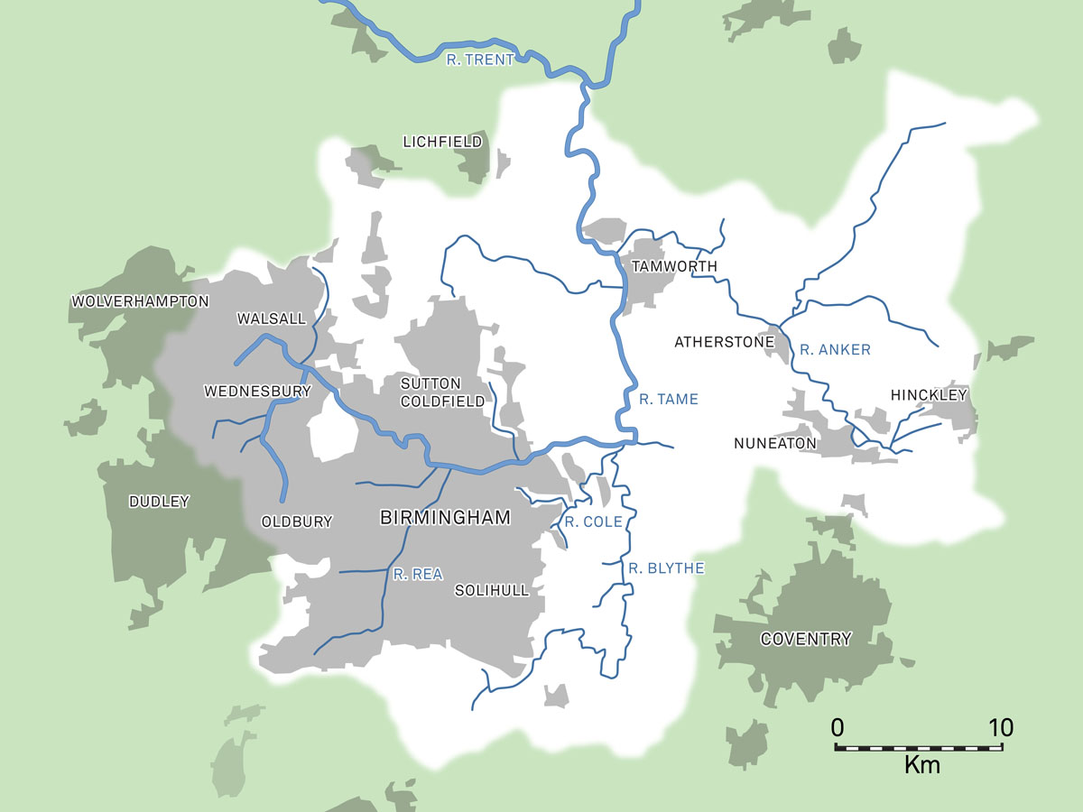

Slide 9
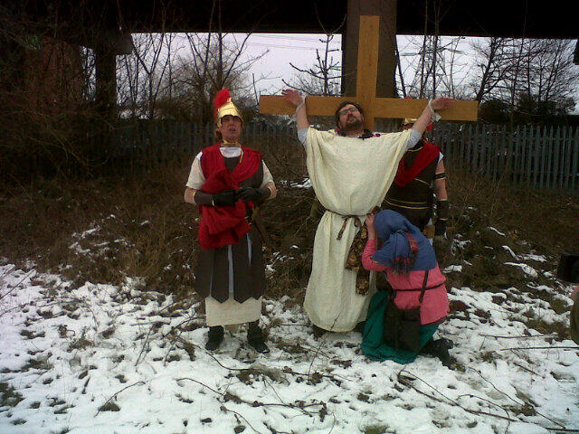

“You may write me down in history with your bitter, twisted lies. You may trod me down in the very dirt, but still like the dust I’ll rise…
So you may shoot me with your words You may cut me with your eyes And I’ll rise... I’ll rise... I’ll rise...
Out of the shacks of history’s shame, Up from a past rooted in pain, I’ll rise... I’ll rise... I’ll rise...
Did you want to see me broken, bowed head and lowered eyes, shoulders falling down like teardrops weakened by my soulful cries…”

Slide 10
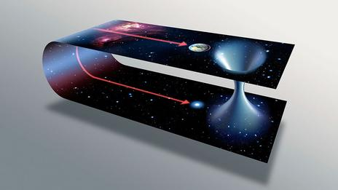
^{‘wormhole hope’}

Slide 11
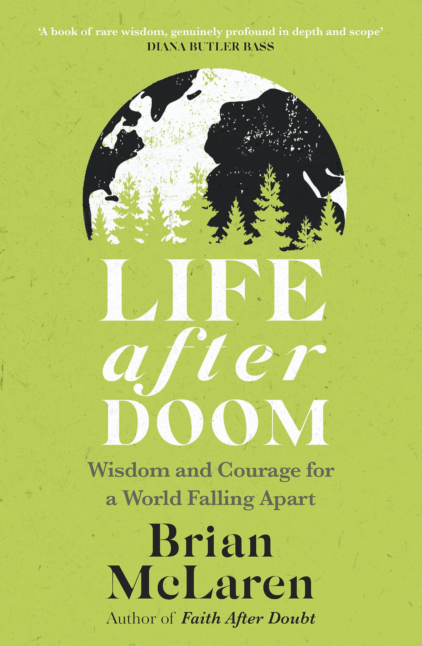
4 scenarios…
Collapse Avoidance
Collapse / Rebirth
Collapse / Survival
Collapse / Extinction

Slide 12
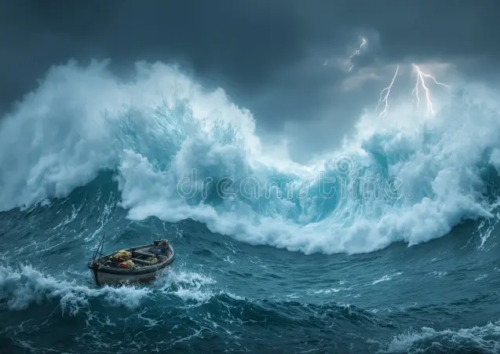
‘collapse’, & some responses to threat/trauma
‘the collapse is already here…’
‘we’re all in the same storm, but we’re not all in the same boat’
‘the ship is sinking, but those on the lower decks are drowning first’ (Azariah France-Williams)
‘the collapse is already here, it's just not very evenly distributed’ (William Gibson, paraphrased)
‘what you people call collapse is living in the same conditions as the people who grow your coffee’ (Vinay Gupta)
some common threat responses (& ‘salvation narratives’?)
‘FLIGHT’ – escape to a better place
‘FIGHT’ – victory over the enemy
‘FREEZE’ – ‘digging in’
‘FAUN’ – adulation of a saviour figure
‘FORCE’ – taking control, ‘fixing it’
(other ‘F’-words are also available…!)
‘DENIAL’ – ‘There is no problem!’
‘DISTANCING’ – ‘It’s their fault / problem, not mine!’
‘DESPAIR’ – ‘It’s all too late!’
‘DEBATE’ – ‘We need to talk about this!’
‘DESPERATE DOING’ – ‘We must do something!’

Slide 13
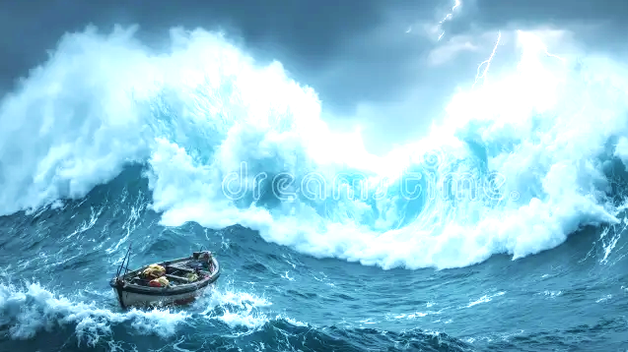
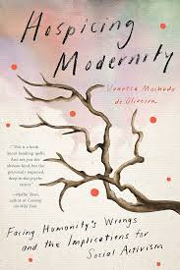
‘Constitutive denials’ (Vanessa Machado de Oliveira)
the denial of systemic, historical, and ongoing violence and of complicity in harm
(the fact that our comforts, securities, and enjoyments are subsidized by expropriation and exploitation elsewhere);
the denial of the limits of the planet and of the unsustainability of modernity/coloniality
(the fact that the finite earth-metabolism cannot sustain exponential growth, consumption, extraction, exploitation, and expropriation indefinitely);
the denial of entanglement
(our insistence in seeing ourselves as separate from each other and the land, rather than ‘entangled’ within a wider living metabolism that is bio-intelligent);
the denial of the magnitude and complexity of the problems we need to face together
(the tendency to look for simplistic solutions that make us feel and look good and that may address symptoms, but not the root causes, of our collective complex predicament).

Slide 14
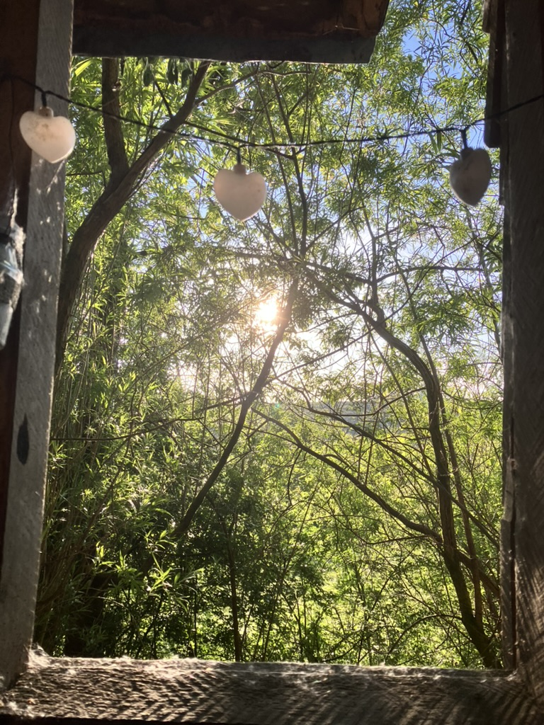
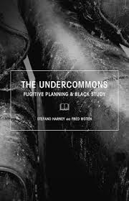
^{facing and following our shit}
denials
shame
disgust
disconnection
dissociation
dis-placement
invitations to ecosystem (multi-species) intimacies
‘this shit is killing you, too, however much more softly’ (Fred Moten)

Slide 15
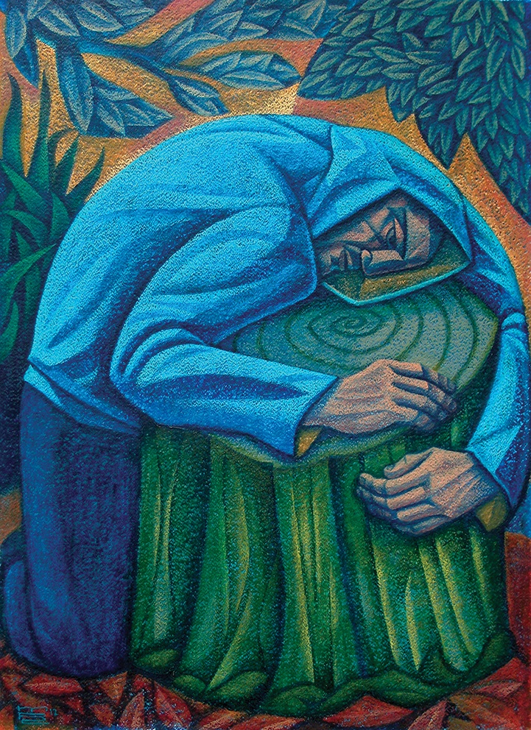
^{hope…? or love?}
‘hope is essential because it motivates… hope is dangerous because it keeps you from facing how bad things really are and responding appropriately.’
(Brian McLaren, Life After Doom)
‘Our great mistake is that we tie hope to outcome.’
^{(Cynthia Bourgeault)}
‘Why am I an activist? Because I’m in love… And if you love, you act to defend your beloved. Of course results matter to you, but they don’t determine whether or not you make the effort.’
^{(Derrick Jensen)}
^{Gethsemane} ^{(Michael Cook)}

Slide 16
^{hope…? or love?}
‘Knowing that you love the earth changes you, activates you to defend and protect and celebrate. But when you feel that the earth loves you in return, that feeling transforms the relationship from a one-way street into a sacred bond.’
(Robin Wall Kimmerer)
‘The signs are all around us. We can see them springing up like wildflowers after the prairie rain. … Sometimes, in this troubled world of ours, we forget that love is all around us. … small signs of love are everywhere. The more you look, the more you will see.’
(Steven Charleston)
‘When people ask me about the grounds for hope, I often ask them to think about the grounds for love. What do you love, why do you love it, and what do you need to sustain your love?’
(Norman Wirzba)

Slide 17
^{what is love?}
‘Love is a form of sweet labour: fierce, bloody, imperfect, and life-giving… a choice we make over and over again.
(Valarie Kaur, See No Stranger)
‘In urgent times, many of us are tempted to address trouble in terms of making an imagined future safe… a comic faith in technofixes, whether secular or religious…
...[or to fall into] a position that the game is over, it’s too late, there’s no sense trying to make anything any better, or at least no sense having any active trust in each other in working and playing for a resurgent world.
Staying with the trouble requires learning to be truly present … as mortal critters entwined…
…to make kin in lines of inventive connection…
…learning to live and die well with each other in a thick present.’
(Donna Haraway, Staying with the Trouble)

Slide 18
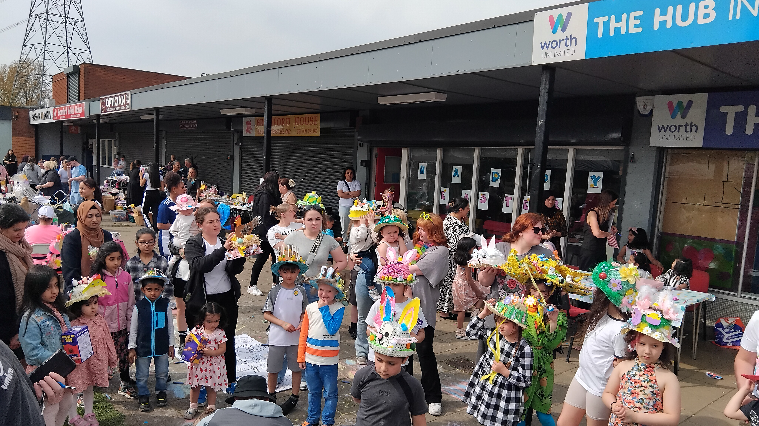
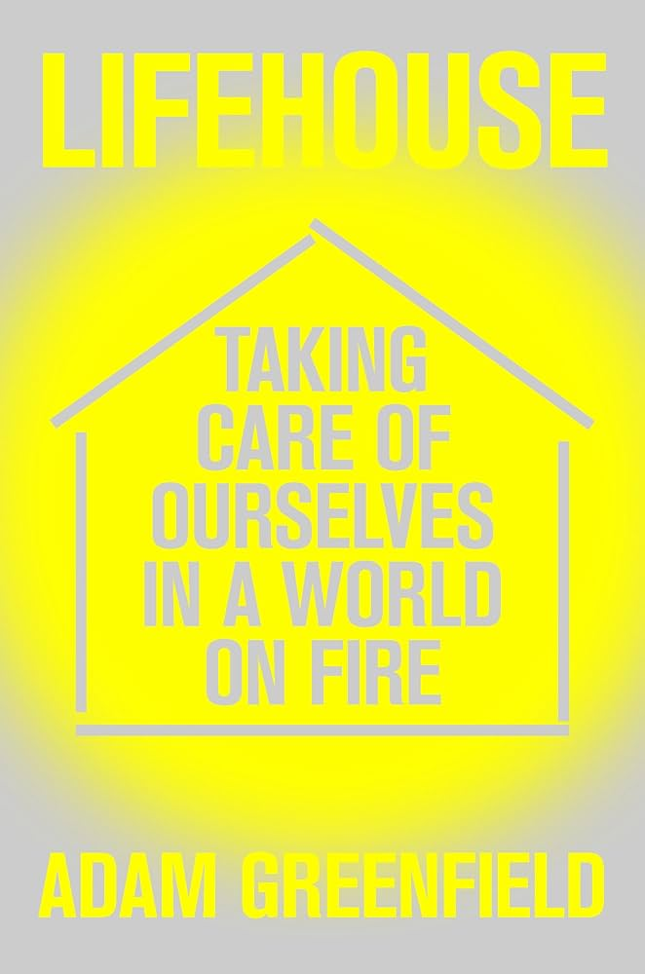
^{hubs… and lifehouses…}
Infrastructure
‘when the grid goes down or the water from the pipes isn’t safe to drink, there ought to be a place close at hand where we can attend to those material needs … that is also a place where we might seek the strength, insight and reassurance of others in the same straits…
‘a foundation for collective resourcefulness…
‘All a Lifehouse can ever do is give people a space in which they might realize a vision of social ecology, tending to themselves and the planet by practicing and experiencing solidarity, mutual care and self-determination.’
Infraculture

Slide 19
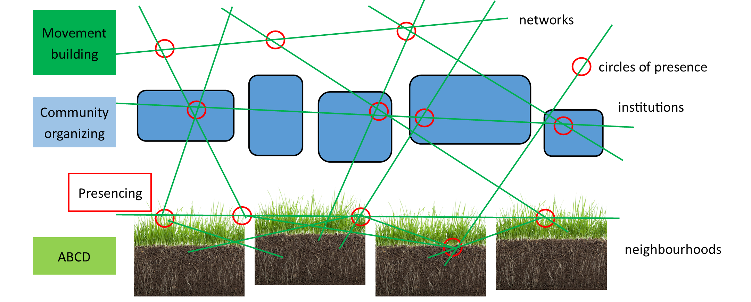
love as ‘commoning’ – in 4 dimensions…
Nurturing community

Slide 20
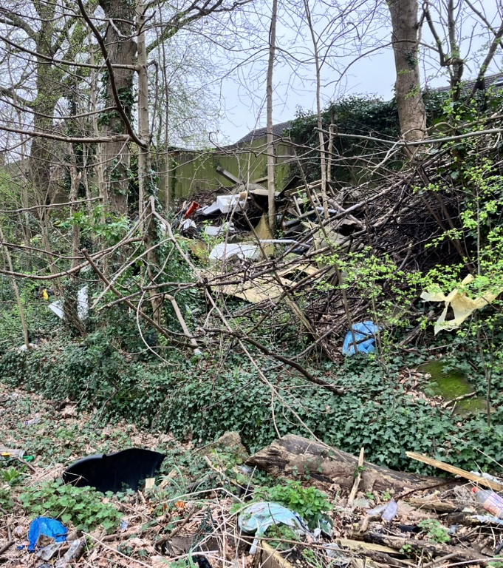
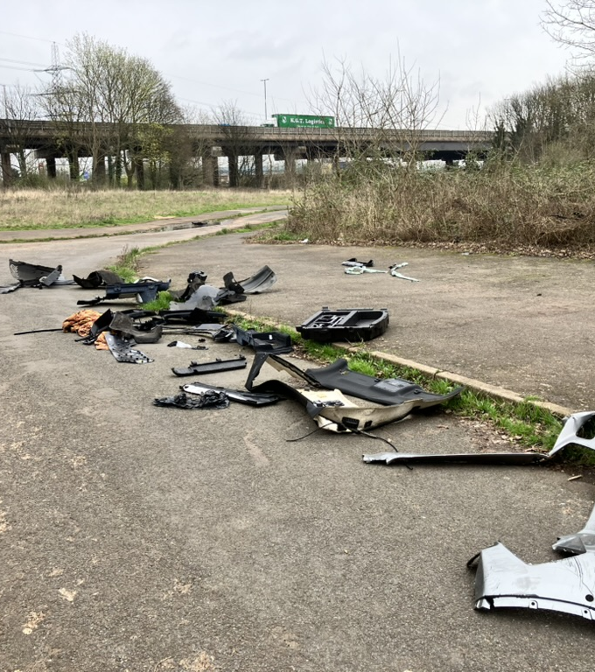
^{wastelands… and edge-places…}
‘At their most unruly and chaotic, edgelands make a great deal of our official wilderness seem like the enshrined, ecologically arrested, controlled garden space it really is. Children and teenagers, as well as lawbreakers, have seemed to feel especially at home in [the edgelands], the former because they have yet to establish a sense of taste and boundaries, and have instinctively treated their jungle spaces as a vast playground; the latter because nobody is looking.’
(Paul Farley & Michael Symmons Roberts, Edgelands)

Slide 21
love as tending the unrestorable
‘Sometimes viable restoration is not possible. Sometimes restoration is a bandage trying to mend a gaping wound. Sometimes restoration is an ungrounded hope motivated by the shadows of the natural and normal. Sometimes restoration is pure social control. I want us to tend the unrestorable places and ecosystems that are ugly, stripped down, full of toxins, rather than considering them unnatural and abandoning them…’
(Eli Clare, Unfurl)
‘…being willing to accept that the dying are beloved – and to treat them as beloved, even when we cannot save them – will soften us. It will make us vulnerable. The tenderness of caring for the dying is not a despairing act but a courageous one. It insists on the goodness of the body even when it seems that the body has nothing left to give. Adopting an orientation of grief means choosing to invest in things that are small, that are temporary, and celebrating them in the broken, fragile beauty they bear in the eyes of God.’
(Hannah Malcolm, Words for a Dying World)

Slide 22
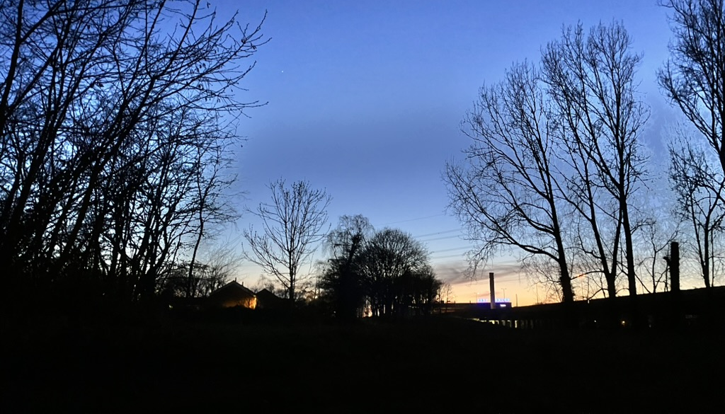
‘dark night’ / ‘collective impasse’
‘helpless, confused, and guilty before the insurmountable problems of our world… every normal manner of acting is brought to a standstill, and ironically, impasse is experienced not only in the problem itself but also in any solution rationally attempted.’
‘...turn toward the feelings ... rather than trying to ignore them, overcome them, fix them, deny them, or justify ourselves.’
(Constance FitzGerald OCD, Desire, Darkness, and Hope)
‘when something breaks, agency is distributed. Forward movement is no longer possible. We now must dance awkwardly.’
(Bayo Akomolafe, on ‘post-activism’)
‘[People don’t need] to be given another, more positive identity [to fill the void]… we need to hold the void open to let [it] speak… How do we lead people to the patience that waits for truth, that is open and imagines differently?’
(Joan Braune, Understanding and Countering Fascist Movements)

Slide 23
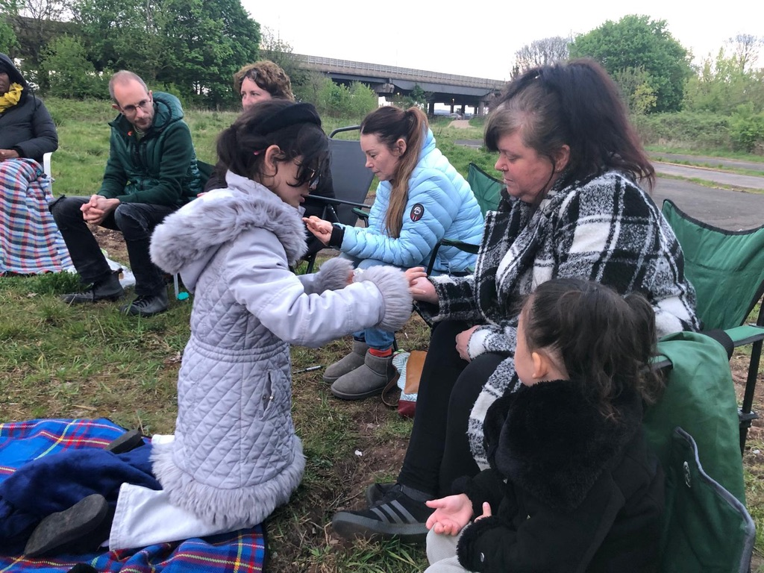
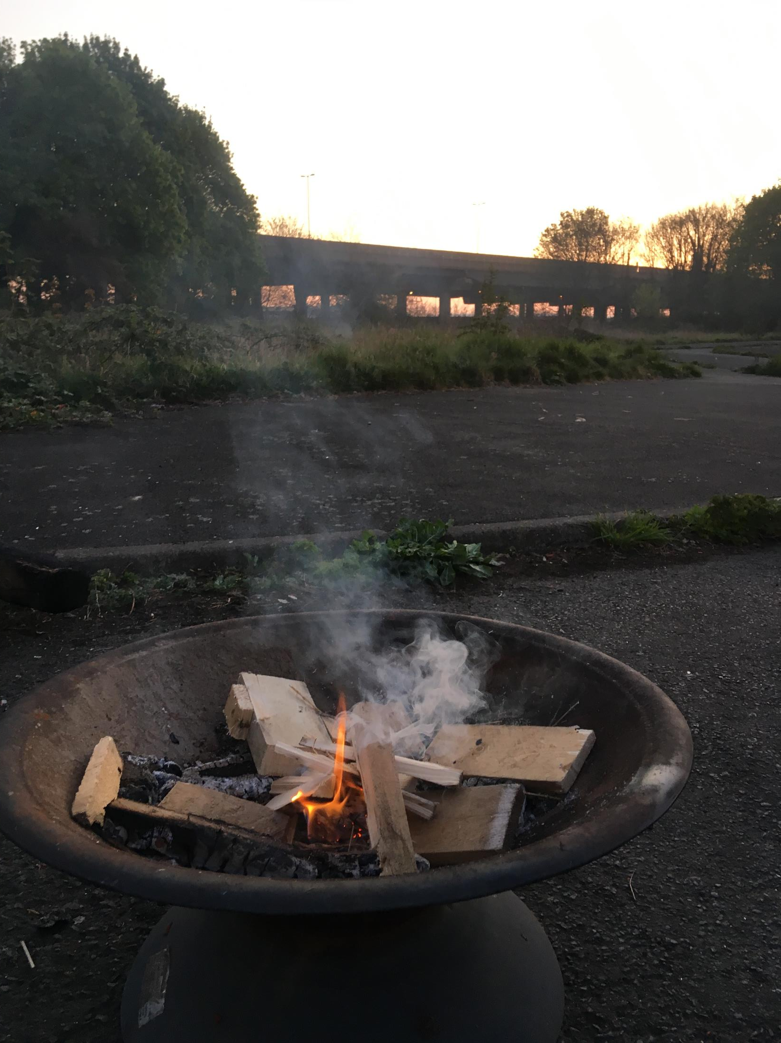
^{love as grieving…}
‘You don’t need to know [your creature-kin] in order to grieve with them. You grieve with them in order to know them.. You may say: It’s too much – all this grief, all this violence and injustice, it’s too hard. You are right… so begin with one…’
(Valarie Kaur, See No Stranger)
‘small circles of radical presence’
(Otto Scharmer)

Slide 24
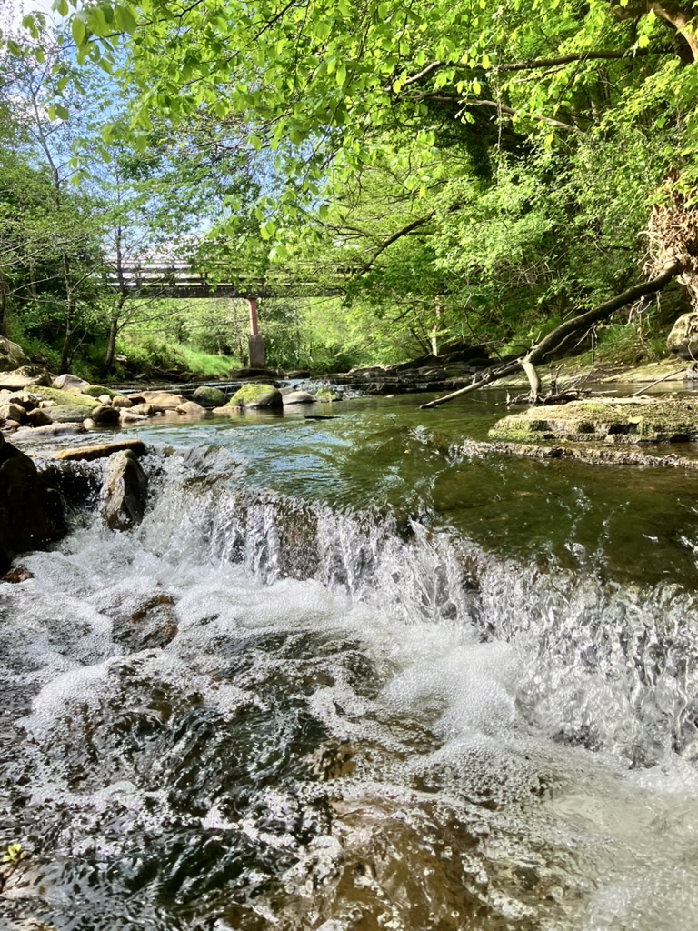
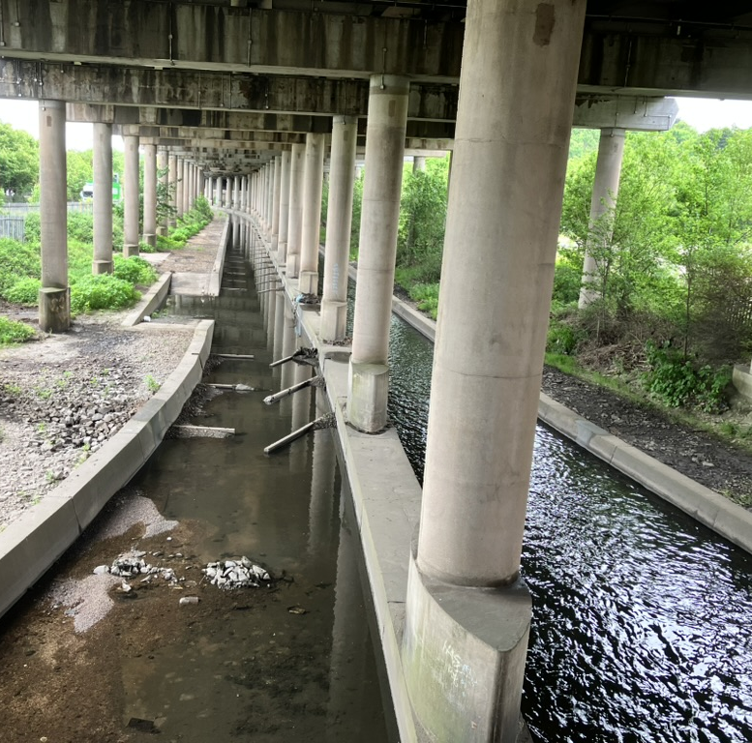
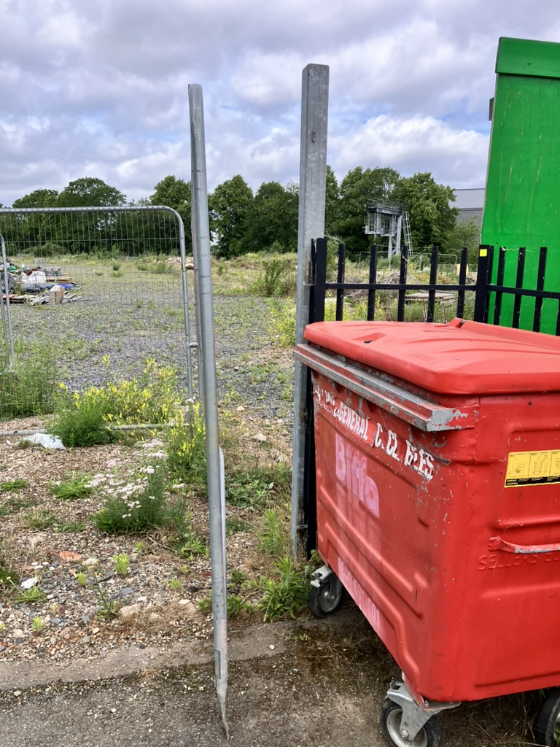
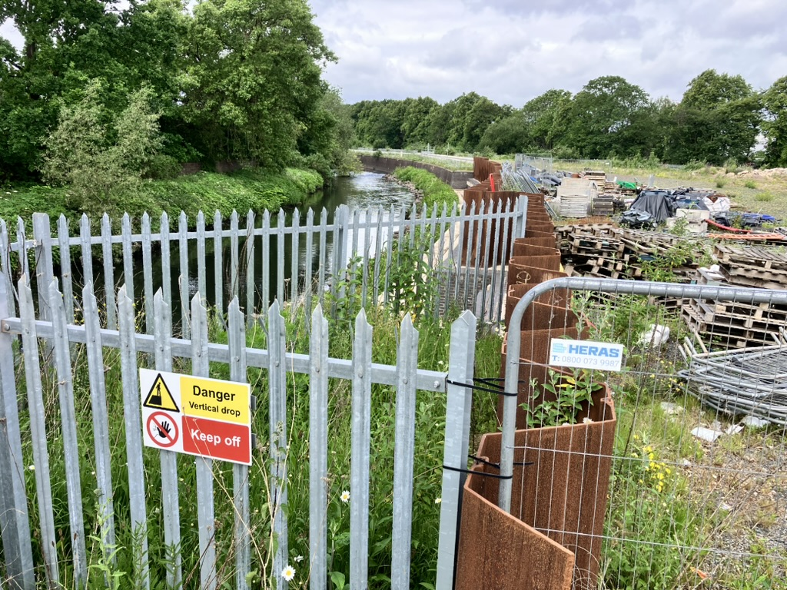
^{love as wandering / trespass…}

Slide 25
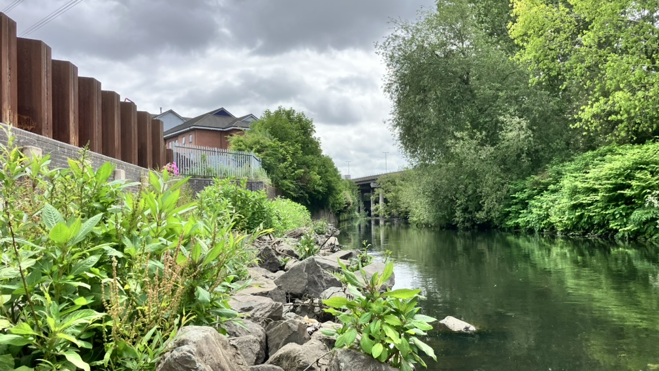

^{love as wandering / trespass…}
Raw sewage discharges into River Tame, 2020: 558,698 hrs (= 64 years)
Raw sewage discharges into River Tame at Bromford estate, 2024: 603 hrs (= 25 days)
Annual profits (Severn Trent, 2023): £509 million
Severn Trent fined, 2024: £2 million

Slide 26

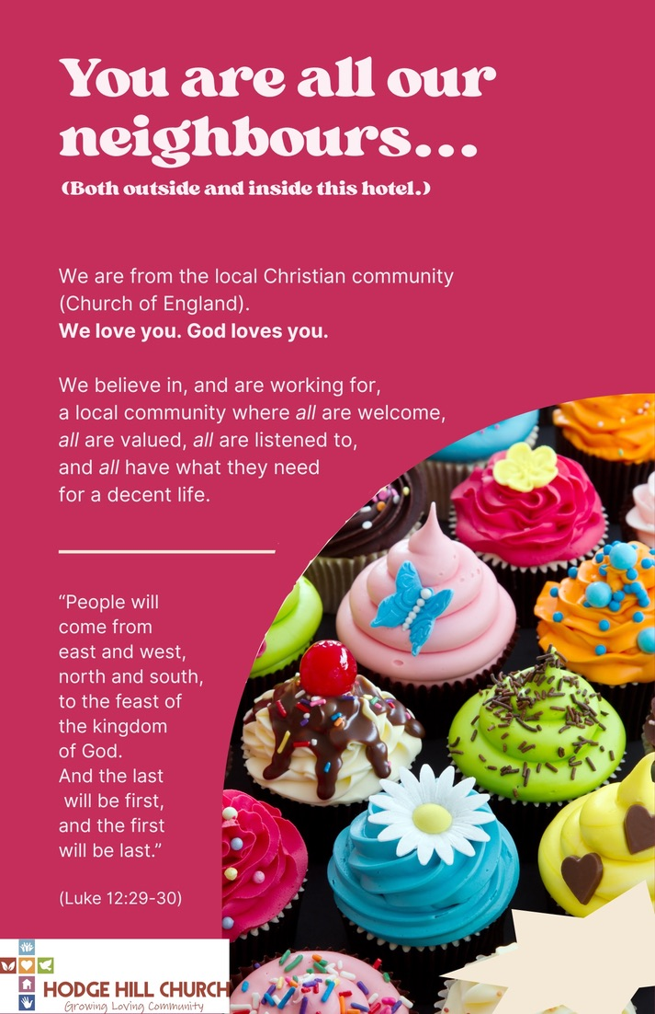
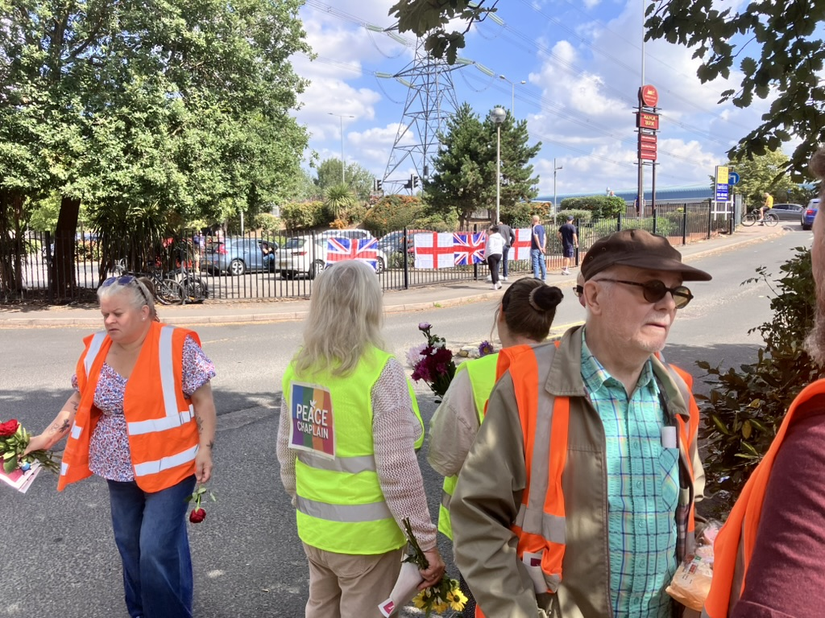
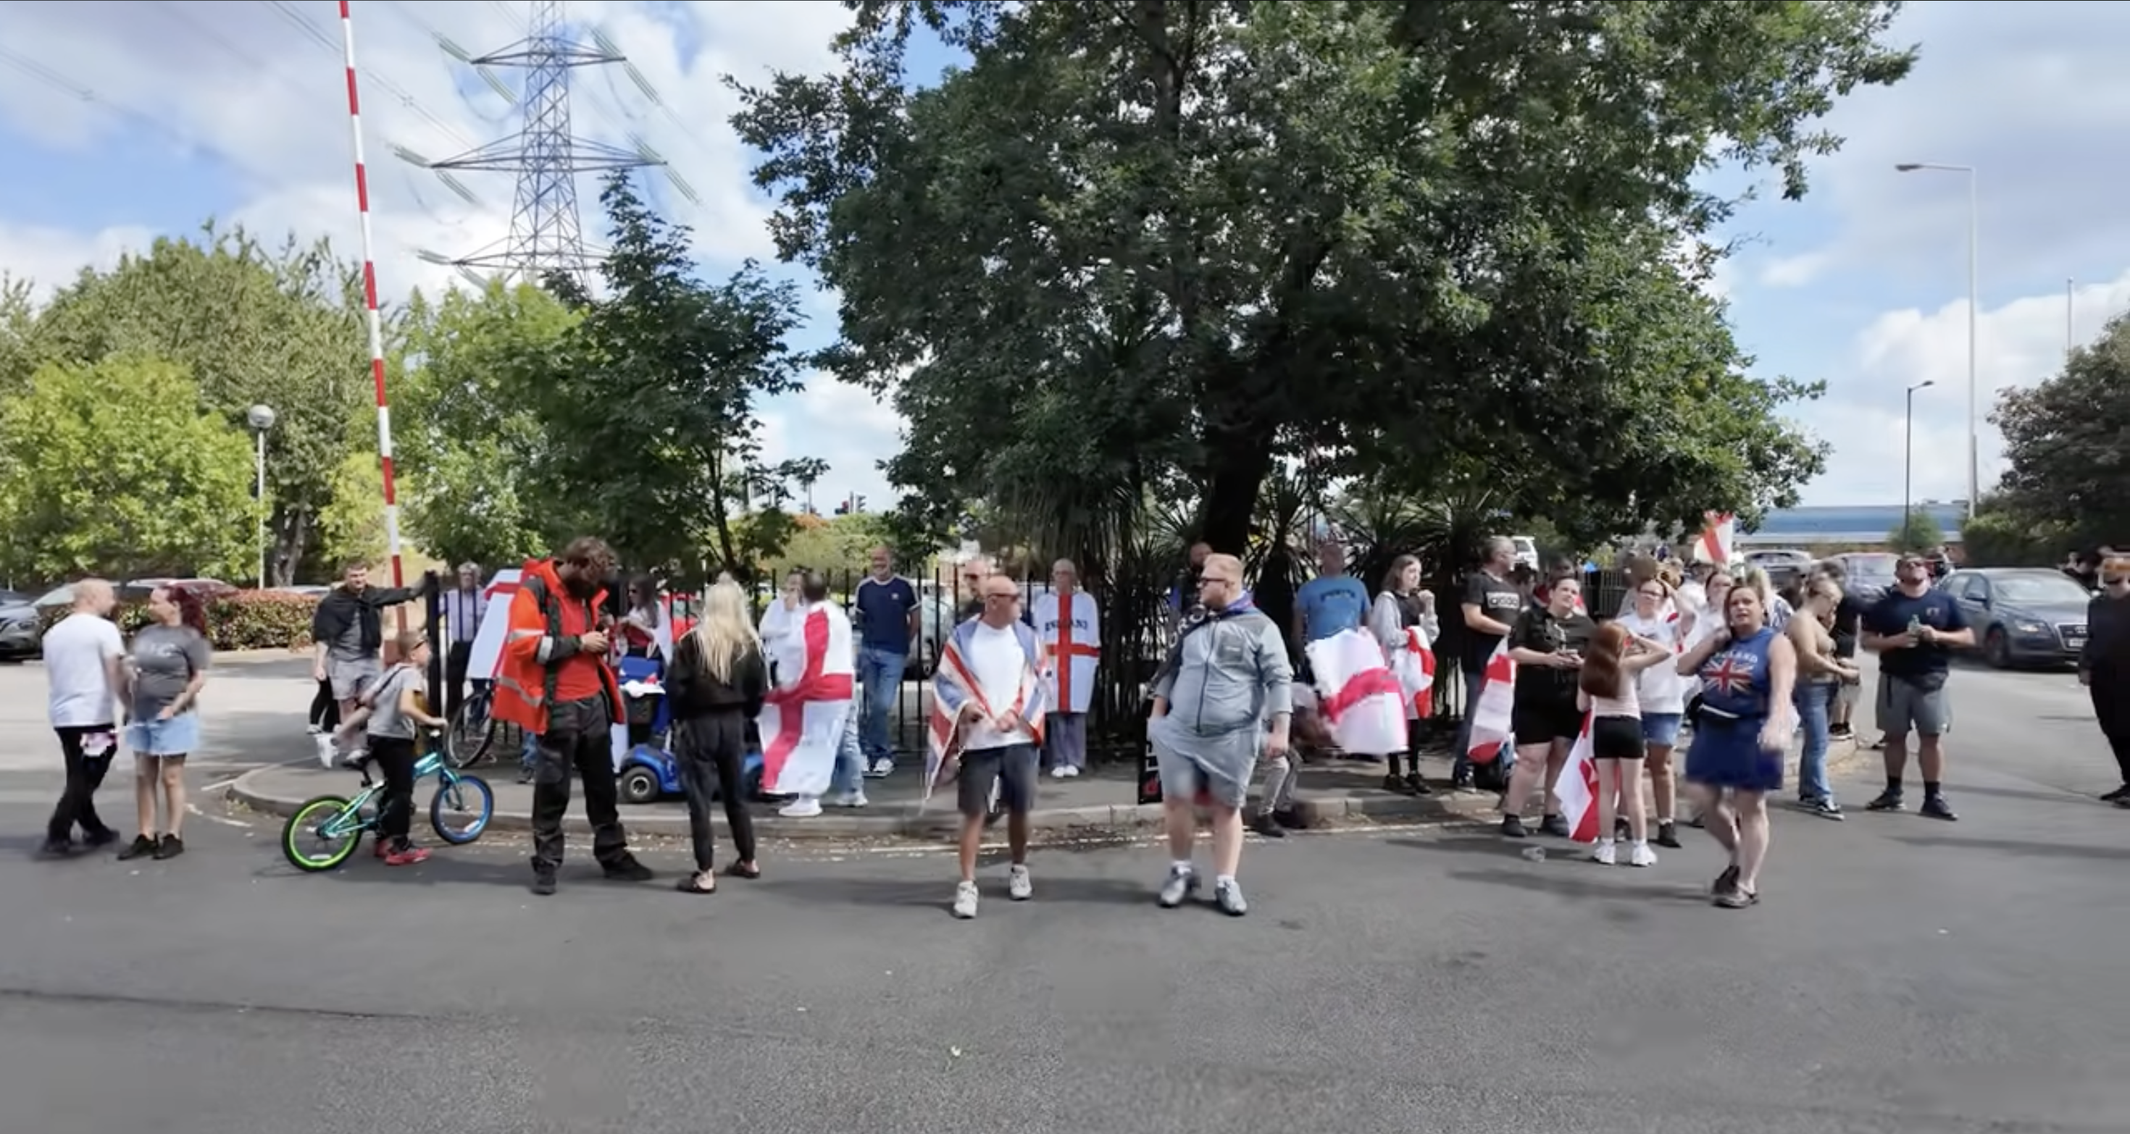
rivers, hotel car-parks… and (un)common ground…

Slide 27
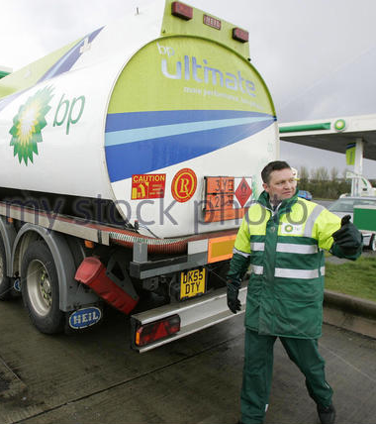
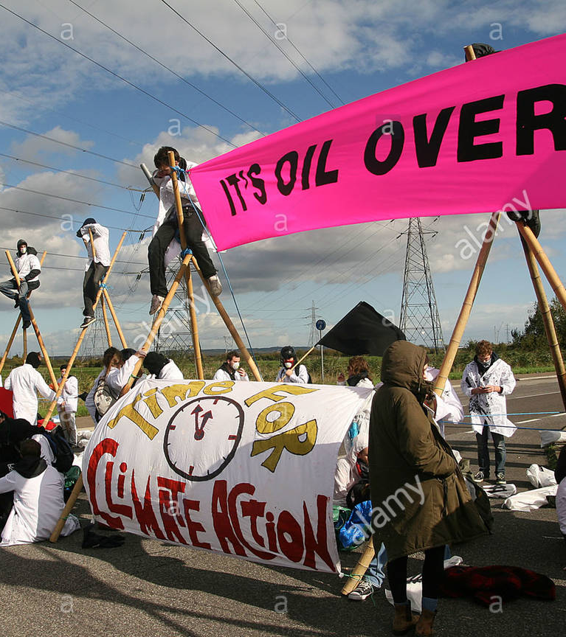
^{love as…}
“Give up activism...”
“Give up activism”
‘instead of asking "what do we do?", I ask: how might we become more available to what is happening? What kinds of gestures let the crack speak? What does it mean to be apprenticed to disfigurement?
To tremble before these questions is not to fix the world. We cannot fix the world. But we can be moved by it. And in that movement, something undoes us. Or rather, the undoing becomes 'us'. And that undoing is everything.
(Bayo Akomolafe, ‘Unlearning Whiteness’)

Slide 28
Each year as heavy rainfalls flood the valleys, spill over gulches, slide the foundations of overpriced houses, invade sewage pipes and send brown water runoff to the ocean, the king tides roll in, higher in its warming, lingering longer and breaking through sandbags and barricades, eroding the resorts.
This is not the end of civilization, but a return to one. Only the water insisting on what it should always have, spreading its liniment over infected wounds. Only the water rising above us, reteaching us wealth and remembering its name.
(Brandy Nalani McDougall, Aina Hanau / Birth Land)

Slide 29
love as wondering… and digging deeper
…wonder is the act that returns us to love... “you are a part of me I do not yet know.”’
(Valarie Kaur, See No Stranger)
denials
shame
disgust
disconnection
dissociation
dis-placement
Learning from Malawi: ‘loss of work and a detachment from the land… “Poverty of the mind”… as a form of mental deprivation influenced by intergenerational and present factors of loss.’
(Anupama Ranawana)

Slide 30
love as wondering… and digging deeper
I’m gonna lay down my heavy load down by the riverside…
I ain’t gonna study war no more..
I’m gonna meet my loving mother down by the riverside…
I’m gonna lay down my sword and shield down by the riverside…

